Slide 1
SAP BTP Architect Training
Day 8
Anubhav Oberoy
www.AnubhavTrainings.com
Follow excellence with sheer passion

Slide 2


DISCLAIMER
The training content and delivery of this presentation is confidential, and cannot be recorded, or copied and distributed to any third party, without the written consent of Anubhav Trainings

Slide 3
Agenda – Day 8
01
Setting up ADT and ABAP instance in cloud
04
Evolution of ABAP and RAP Programming
02
05
Introduction to CDS Data models
Implementation types
03
06
Challenges for ABAP Developers
Unmanaged Implementation

Slide 4

What is ABAP Enviornment
SAP BTP is a public cloud offering and it has one of the service called ABAP Application instance. This is the service we call as ABAP on cloud.
Benefits of Cloud solutions
Faster innovation cycle
You don’t have to worry about infrastructure but you more care about your focus area which development.
In past, all the new custom features were development inside the ERP which has risk of destabilizing our ERP. We can now use ABAP on cloud to develop new functionality by keeping our ERP safe and secure. Yet we can integrate to RW data to ERP. Idea is to keep your core clean
Scalability, we can scale application any time both horizontally and vertically
Apply additional compliance

Slide 5
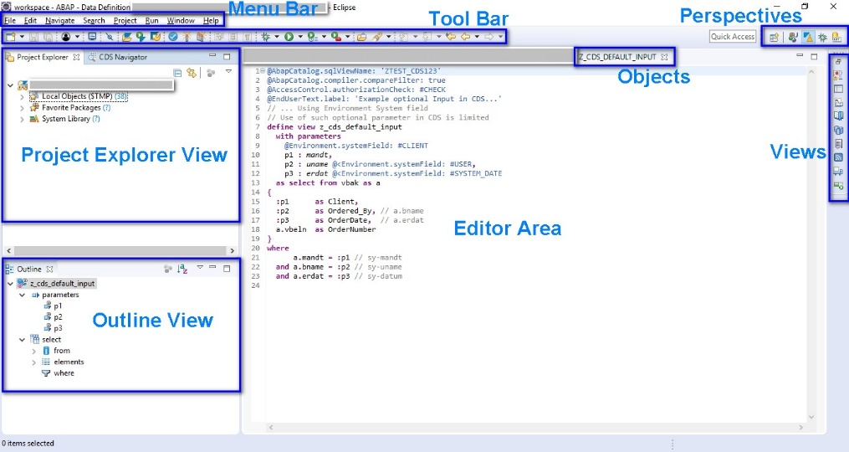
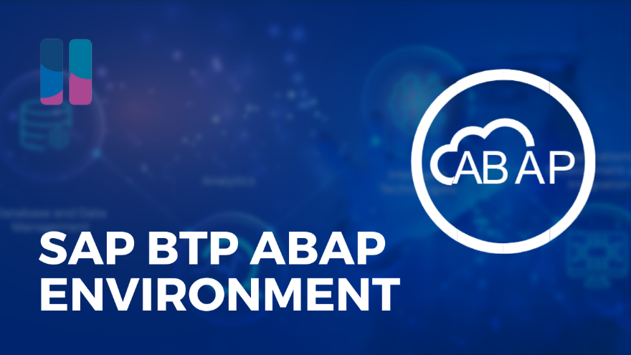
Hands on : Setting up ADT and ABAP Instance
Pre-requisite
JDK min 1.8
For Windows OS: Microsoft Visual C++ 2013 (x64) for communication with the back-end system is required.
Main setup
To install the front-end component of ADT, proceed as follows:
Get an installation of Eclipse 2022-03 (x86_64) (e.g. Eclipse IDE for Java Developers)
In Eclipse, choose in the menu bar Help > Install New Software...
Enter the URL https://tools.hana.ondemand.com/latest
Press Enter to display the available features.
Select ABAP Development Tools and choose Next.
On the next wizard page, you get an overview of the features to be installed. Choose Next.
Confirm the license agreements and choose Finish to start the installation.

Slide 6
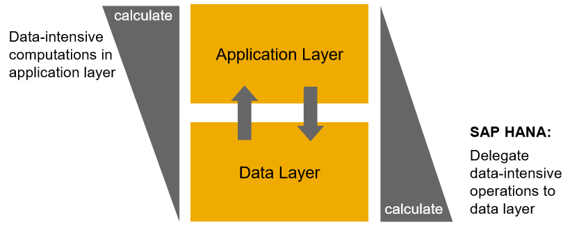
Introduction to CDS
CDS is an extension of SQL in ABAP system. The main advantage of CDS is to achieve code-to-data paradigm. CDS is available for multiple purpose
DDL (data definition layer)
DQL (data query language) – CDS Views and CDS entities
DCL (data control language)
DEL (data expression language)

Slide 7
Why we need CDS views?
Hide complexity – Imagine we have a ERP system, usually data in ERP is spread across MULTIPLE tables. Reading the data with Query becomes complex and error prone. We code VIEWS with all selections, conditions, and associations (joins). It provides data from functional point of view.
Security – We do not want to give direct access to DB tables, because tables are prone to attacks and security breach. Hence we create views, by masking (hiding), projections of the relevant data for the business use case. We additionally add ROW level security.
Modularization – We can develop complex functionalities by small size modules. Which calls and orchestrates between each other. It brings reusability and reduces redundancies.
In context of SAP CDS, we have annotations, framework consumptions, ease of development, support for tools, support for multiple use case, industry standard, inherent documentation.
Private views
Interface views
Consumption views
Developers only access to be used within other views, direct consumption should be prohibited.
Basic
Composite
They are reusable views can be consumed for any purpose, as they build a bridge between tables. Basic views are pure master, transaction data but composite views are combination of master and transaction data.
Used for final consumption built on top of interface views.

Slide 8



Challenges for ABAP Consultants
UI
Create A/c documents
Common needs
Create application logic
Insert, update, delete, validate, select data
Perform validations
Check customizing
Handle locks
Manage Documents
Application Code
I, U, D, S, V
Search Documents
Validate before save
Alex, ABAP Developer,
SAP FICO
UI
Challenges
Thinks differently
Adapt application code
High maintenance
No standardization
Different coding practices
Lack of standard
Create Sales Orders
Manage Sales Orders
Application Code
I, U, D, S, V
Search/Filter SalesOrder
Compute Sales total
Stella, ABAP Developer,
SAP SD

Slide 9
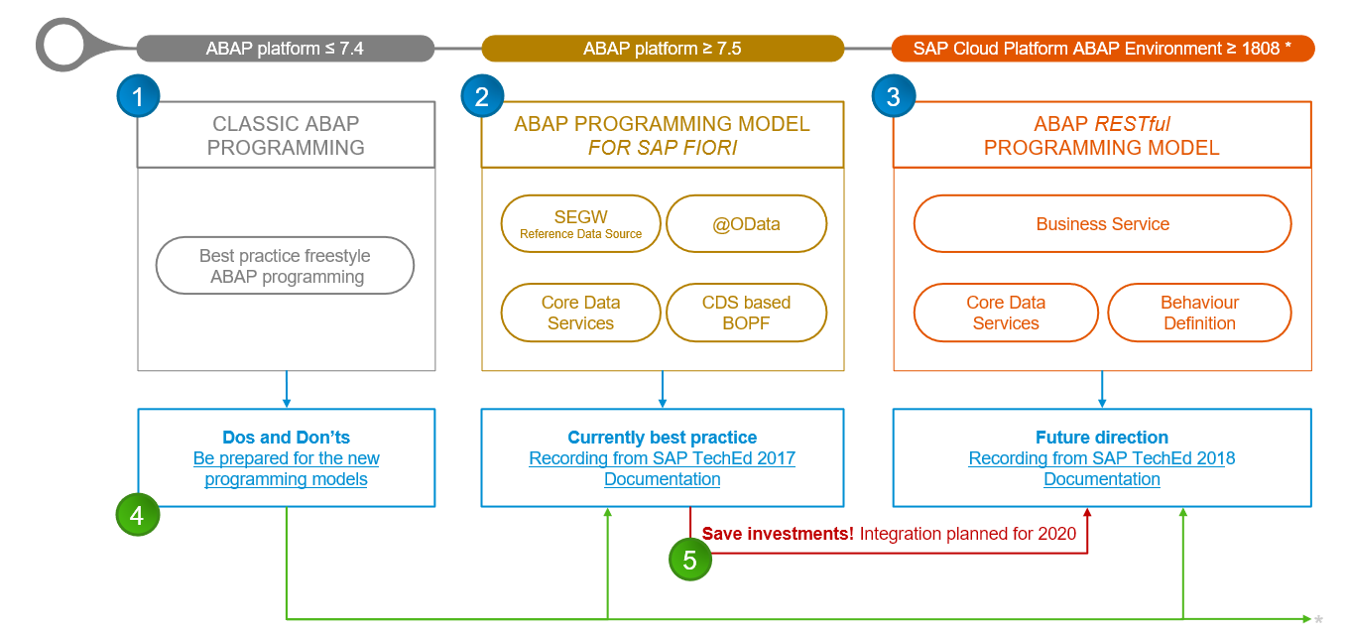
Evolution of ABAP Programming

Slide 10
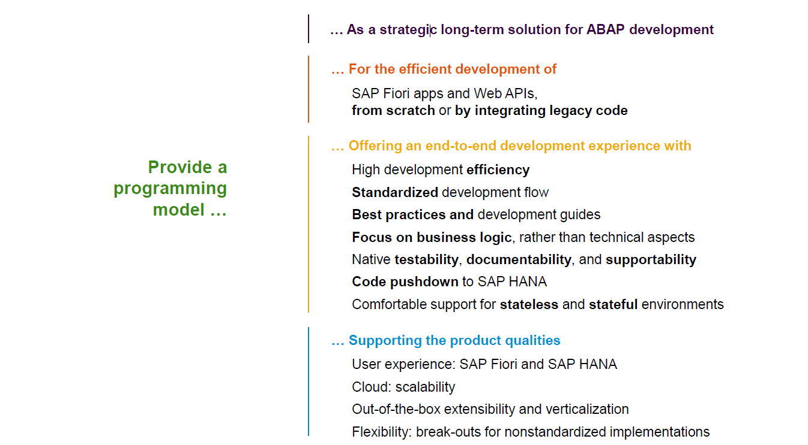
RAP - Restful Application Programming

Slide 11
Definition - RAP
The ABAP RESTful programming model defines the architecture for efficient end-to-end development of intrinsically SAP HANA-optimized OData services (such as Fiori apps) in SAP Business Technology Platform ABAP Environment. It supports the development of all types of Fiori applications as well as A2X services. It is based on technologies and frameworks such as Core Data Services (CDS) for defining semantically rich data models and a service model infrastructure for creating OData services with bindings to an OData protocol and ABAP-based application services for custom logic and SAPUI5-based user interfaces .
The whole architecture is based on
CDS views – will helps you to create semantically rich data model.
Business Object here is a node inside a tree data structure which is achieved by using root keyword at CDS view level, this is needed only if we want to add transactional capability.
Finally create a service using service definition and service binding .
The binding will confirm the Purpose of service – API or Fiori.
UI layer with the Fiori app using elements.

Slide 12
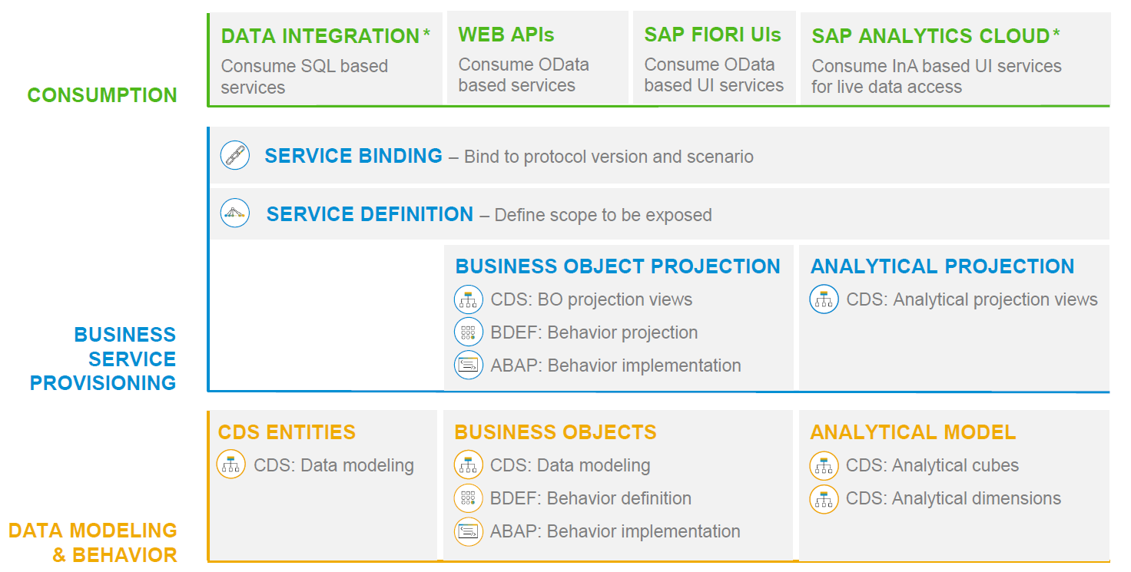
RAP – Development Big picture

Slide 13
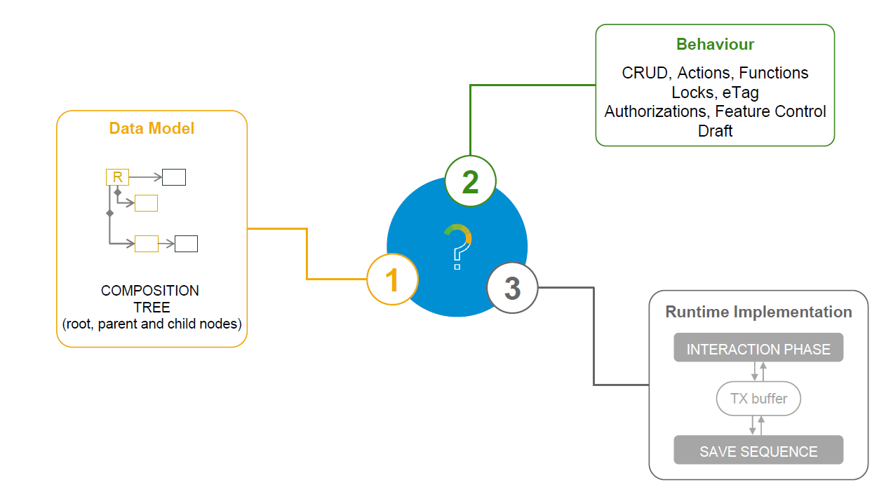
What is Business Object

Slide 14
Types of Implementation (Scenario)
Brownfield Implementation
Is used when we want to create a transactional application which can insert, update, delete data from the system by writing your own logic
You already have Business logic with you and you want to use that business logic to perform transactional capability
You are own your own to manage your implementation.
02. Managed Scenario
Greenfield Implementation
01. Un-Managed Scenario
Is used when we want to create a transactional application which can insert, update, delete data from the system by using the framework provided implementation
You do not have Business logic with you and you want system to create business logic for you automatically.

Slide 15
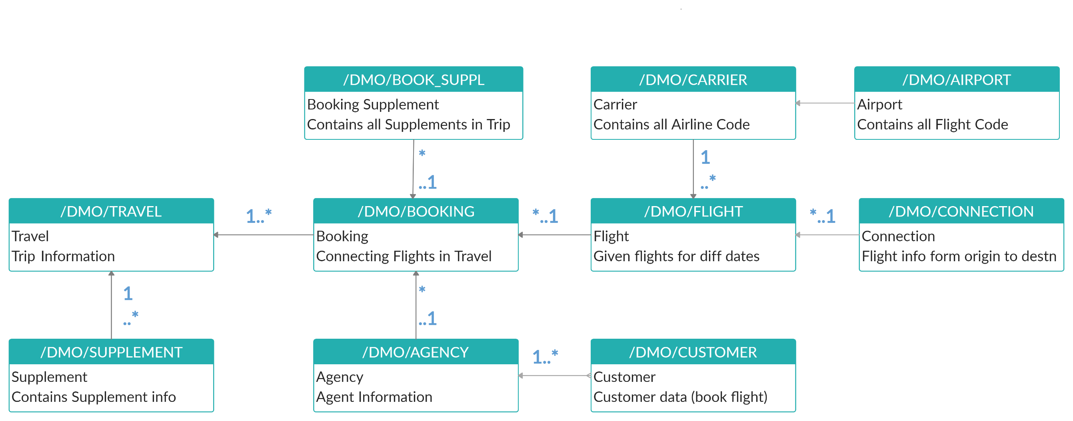
Understanding Data Model

Slide 16
Development of Base objects
Fiori Application
Service Binding
Purpose - UI
Service Definition
Expose Entities
ZATS_XX_U_TRAVEL_SD
Composition Tree
Business Object
Travel (root)
ZATS_XX_U_TRAVEL
I_Currency
Agency
ZATS_XX_U_AGENCY
Customer
ZATS_XX_U_CUSTOMER
I_Country

Slide 17
Unmanaged Implementation
The scenario describe below focus unmanaged implementation type of business object provider in context of RAP programming.
For the unmanaged implementation type, the application development must implement the essential components of the REST contract itself. In this case, all the required operations (create, update, delete or any application specific actions) must be specified in the corresponding behavior definition before they are manually implemented in ABAP.

Slide 18
Behavior Definition
A Business object behavior definition us ab ABAP repository object that describes the behavior of a business object in context of RAP.
A behavior definition is defined using BDFL (Behavior definition Language) and comprises capabilities and modeling aspect of the business object node and nodes, for example supported operations (create, update, delete) and additional actions or lock dependencies.
A behavior definition always refers to a CDS data model. This reference result from the name equality with the root entity. This means the CDS data model must exist before the BDEF is create.
A BDEF relies on the CDS root entity.
One BDEF exactly refers to one root entity and one CDS root entity has maximum of one allowed behavior definition. (relation is 0..1), which also handles the associated child entity.
The implementation of BDEF can be done in a single ABAP class pool (behavior pool) or can be split across arbitrary number of global classes. You can assign any number of behavior pool to a behavior definition (1..n).
Behavior Pool
CDS root Entity
ZABC
BDEF - ZABC
0..1
1..n
CDS entities
create;
update;
create code

Slide 19
Behavior Pool
The transactional behavior of a business object in context of RAP is implements in a global ABAP class or classes. These special classes are dedicated only to implement orchestration logic of our business object and its operations.
The implementation of a behavior definition can be done in one or split across multiple classes.
You can assign any number of behavior classes to a behavior definition, within a single global class, you can define multiple local types(class pools) that handle BO behavior.
The global classes are just the container but actual implementation code is implemented in local classes inside the pool.

Slide 20
Hands on: Develop Unmanaged App

Slide 22

What We Did
Let’s Summarize

Slide 23

www.anubhavtrainings.com
Thank You
End of Day 8

Slide 24


We’re committed to empower you to be
#FutureReady
through powerful training solutions.
We build the workforce of the future.
280+
Corporate Clients
80,000+
Learners Trained
28000+
Learners Placed
FREE WEBINARS
Sign up for free webinars with industry experts every fortnight!
Enroll Now!
Contact us today!
https://anubhavtrainings.com

